Slide 1
Dengue Vaccines
Market/Disease Landscape
04-June-2021

Slide 2
Executive summary
The overall dengue vaccines market is projected to cross US$ 1.4 Bn by 2031. TAK-003 from Takeda is the most advanced vaccine currently in the pipeline.
The top five countries with highest number of dengue cases are Brazil, Vietnam, Peru, the Philippines, and Nicaragua.
Future market and pipeline products
Highest number of dengue cases
Dengue and safety measures
Sanofi is the first dengue vaccine producer in the market. Dengvaxia® is licensed in 20 countries and the efficacy of Dengvaxia against severe dengue in seropositive vaccinees in the phase 3 trials was 84%.
Major player and the marketed dengue vaccine
Country wise distribution
African Union has the highest growth rate of Dengue among all the regions, and more than 100% new cases were recorded with in a month. However, in most of the other countries, a pronounced decrement in cases is observed in since 2020.
Disease burden and Epidemiology
Around 3 billion people (40%) in the world, live in areas with risk of dengue. Southern parts of Africa is expected to be at higher risk in future due to favorable temperature and increasing rainfall.

Slide 3

Disease Overview for Dengue

Slide 4


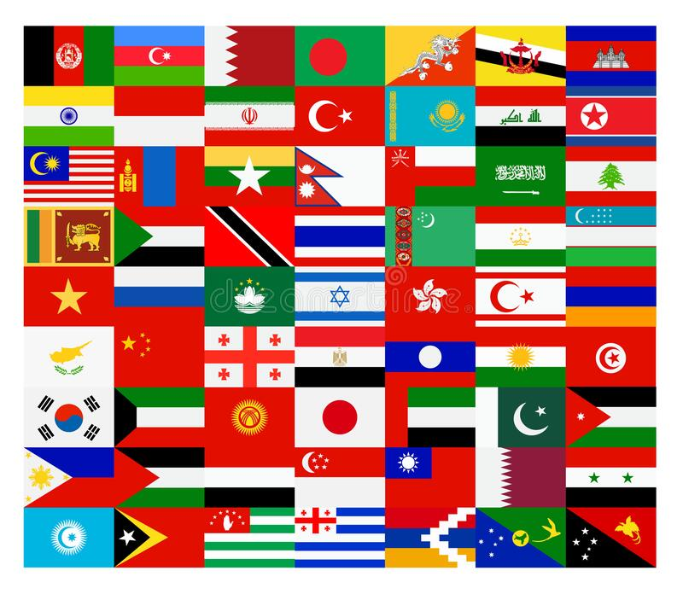
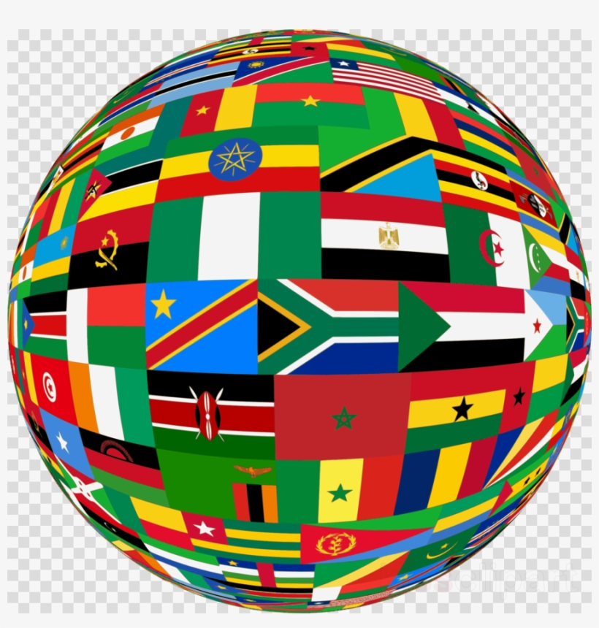
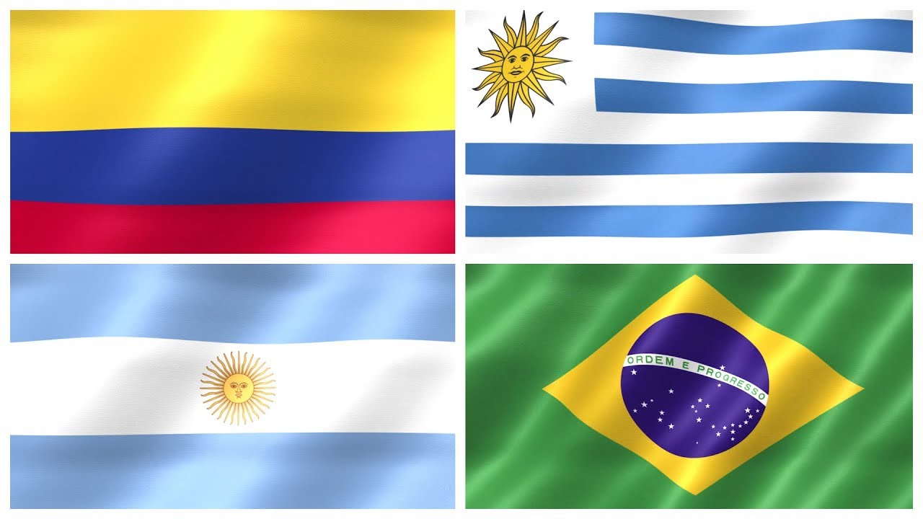
The top five countries with highest number of dengue cases are Brazil, Vietnam, Peru, the Philippines, and Nicaragua.
Asia
(N=76,819)
Africa
(N=14,259)
Key Insights
The top countries in South America with most number of cases in 2021 are: Brazil, Peru, Nicaragua, Colombia, and Paraguay
Out of total cases in South America, 87% (N=426,592) are located in Brazil (2021)
Out of total cases in 2021 in Asia, around 70% are located in SEA region. Mostly in Vietnam (N=24,000), and the Philippines (N=17,630)
South America
(N=487,878)
Higher cases
Milder cases
Lower cases
Data for countries like Saint-Martin, Saint-Barthelemy, Martinique, Bangladesh, India, Indonesia, Myanmar, Ethiopia, Mayotte, Mauritius, Mauritania or Senegal, Federated States of Micronesia, the Republic of the Marshall Islands, Wallis and Futuna, Fiji are not updated
Australia and the Pacific has only around 312 cases in total
Source: ECDC; PAHO; Sehatnegeriku; NVBDCP
Recent data, updated on may 2021
Notes:
https://www.ecdc.europa.eu/en/dengue-monthly
https://www3.paho.org/data/index.php/en/mnu-topics/indicadores-dengue-en/dengue-nacional-en/252-dengue-pais-ano-en.html
https://sehatnegeriku.kemkes.go.id/baca/umum/20201203/2335899/data-kasus-terbaru-dbd-indonesia/
https://nvbdcp.gov.in/index4.php?lang=1&level=0&linkid=431&lid=3715

Slide 5
Country Wise Distribution
African Union has the highest growth rate of Dengue among all the regions, and more than 100% new cases were recorded with in a month. However, in most of the other countries, a pronounced decrement in cases is observed in since 2020.
South America
Asia
Africa
In some countries like Laos, Singapore, Bangladesh, Taiwan, Nepal, and China the total number of cases are very low, and makes up to a combined number of only 327 cases in 2021.
Source: ECDC; PAHO; Sehatnegeriku; NVBDCP; Unitedengue
Notes:
https://www.ecdc.europa.eu/en/dengue-monthly
https://www3.paho.org/data/index.php/en/mnu-topics/indicadores-dengue-en/dengue-nacional-en/252-dengue-pais-ano-en.html
https://sehatnegeriku.kemkes.go.id/baca/umum/20201203/2335899/data-kasus-terbaru-dbd-indonesia/
https://nvbdcp.gov.in/index4.php?lang=1&level=0&linkid=431&lid=3715
https://www.unitedengue.org/regionaldengue.html

Slide 6
Disease Burden and Epidemiology
Around 3 billion people (40%) in the world, live in areas with risk of dengue. Southern parts of Africa is expected to be at higher risk in future due to favorable temperature of dengue virus and increasing rainfall.
1
Epidemiology
3
Global burden of dengue
Dengue has emerged as a worldwide problem since the 1960s, and the disease is common in many popular tourist destinations in the Caribbean (including Puerto Rico), Central and South America, Southeast Asia, and the Pacific Islands
Around 3 billion people (40%) in the world, live in areas with risk of dengue
Transmission of dengue depends on periodicity, with varies among different regions. Southeast Asia peaks in three to five years (peak time in Thailand and Myanmar is from May to October and June to December in Malaysia and Vietnam) whereas Brazil peaks in four to five years
However, dengue circulates year-round in tropical and subtropical areas and is highly interrelated with temperature, rainfall, and vector fluctuation with seasonality.
As per WHO, reported cases of dengue has increased over eight folds, from 505,430 cases in 2000, to over 2.4 million in 2010, and 5.2 million in 2019
Increased mortality rate between the year 2000 and 2015 from 960 to 4032.
Around 50% of the world’s population is now at risk. There are an estimated 100-400 million infections each year
Almost 53% reduction in severe dengue cases was recorded during 2017. After 2016, due to post-Zika outbreak there was a significant decline of cases of dengue and the exact factors are not known
All four dengue virus serotypes (DENV-1, DENV-2, DENV-3, and DENV-4) are mostly circulating in the Southern region of America, and increasing the severity of the disease
2
Risk factors
4
Future prospects
Infection rate is higher in young adults in non-endemic areas. While in endemic districts, children have the highest incidence rate and make up 85% of total cases in Thailand, which is mainly in the aged 8- to 9-years group
DHF has become the main reason for hospitalization and death for children. Humans are the principal amplifying hosts of DENV
In addition, once infected, the person may enter unapparent infection with a probability of >50%. The ratio of unapparent to apparent infection reached 2.2:1. Unapparent infections play a significant role in transmission.
Much of the southeastern USA, coastal eastern China and Japan is predicted to become suitable by 2050
Southern Africa, and Sahel in West Africa is likely to see the biggest change in dengue risk due to the favorable temperatures and increased rainfall
Areas in central East Africa, and India are predicted to see declining suitability as it is becoming hotter and drier
Europe is expected to get increased number of cases from 0.22% in 2015 to only 0.62% in 2080
Globally, 2.25 billion more people will be at risk of dengue in 2080
Source: CDC; WHO; ScienceDirect; Nature
Notes:
https://www.cdc.gov/dengue/areaswithrisk/index.html
https://www.who.int/news-room/fact-sheets/detail/dengue-and-severe-dengue
https://www.sciencedirect.com/science/article/pii/S2414644719300077
https://www.nature.com/articles/s41564-019-0476-8

Slide 7
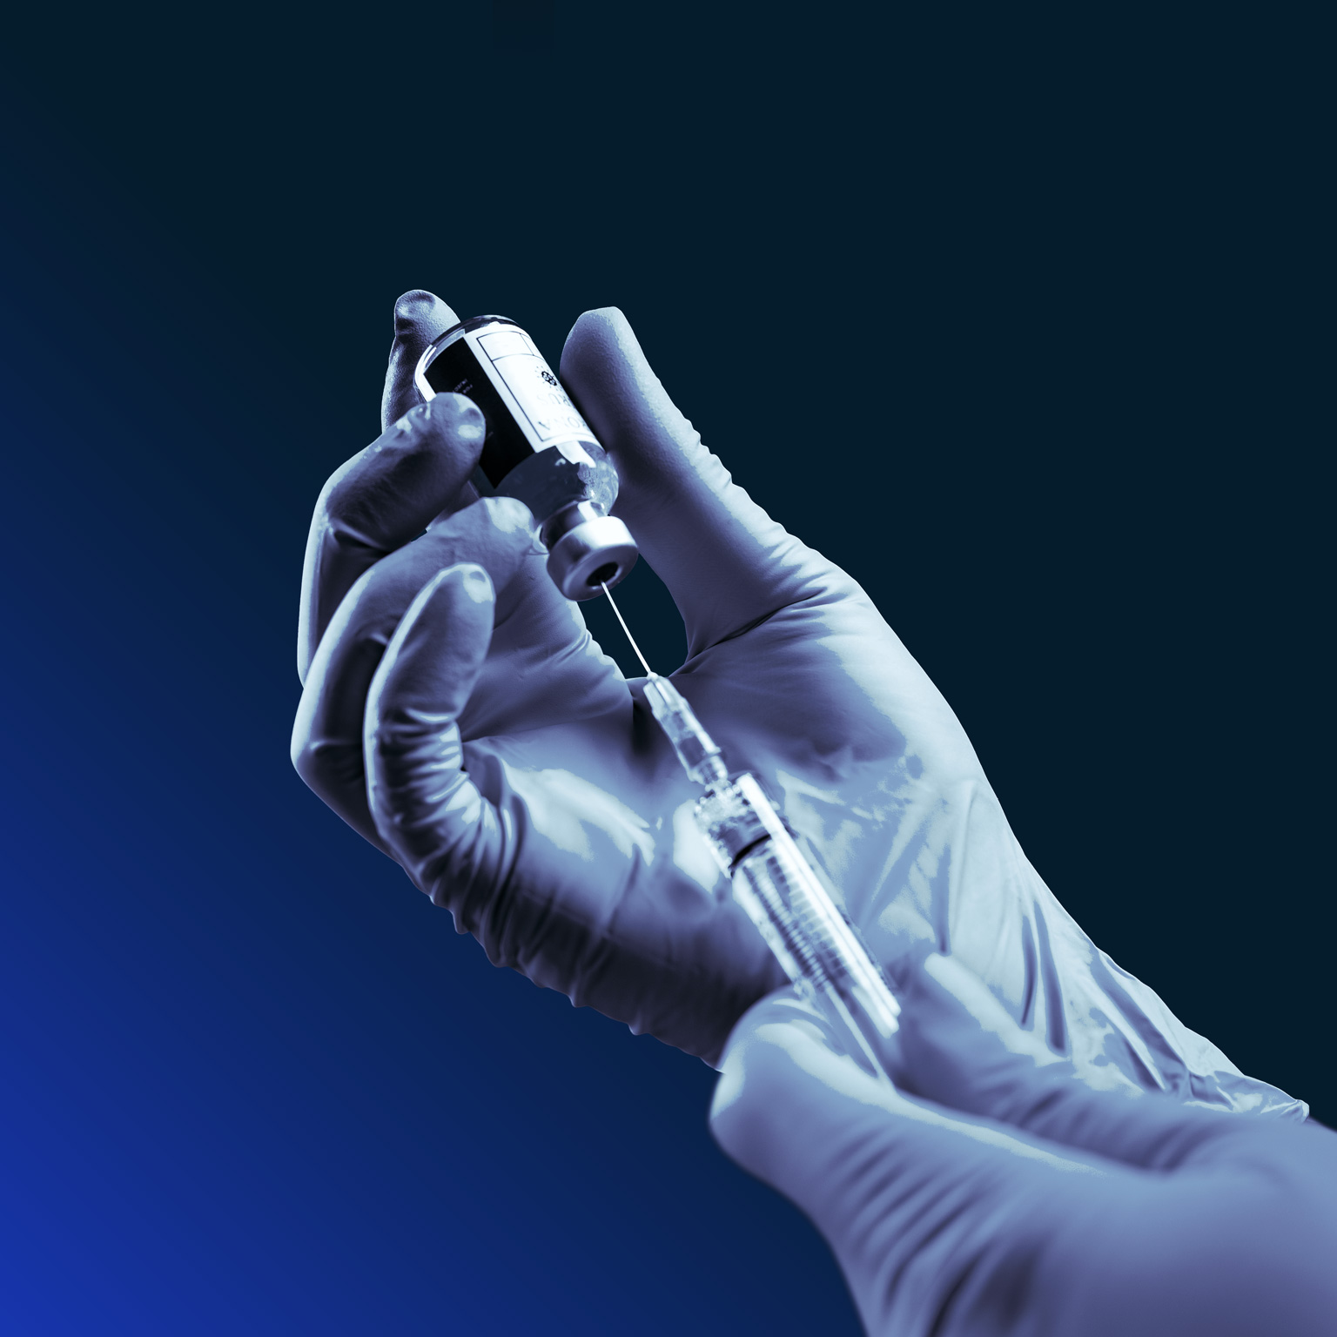
Major player and the marketed Dengue vaccine

Slide 8
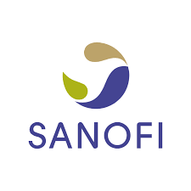


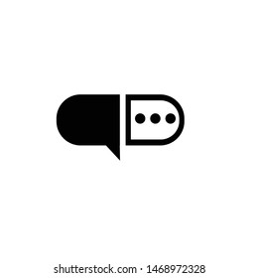


















Major Player and The Marketed Dengue Vaccine
Company Overview
Dengvaxia Vaccines
Dengvaxia® is licensed in 20 countries
A live attenuated tetravalent vaccine consists of chimera (pre-membrane, and envelope genes of all four DENV types)
Business operations :
A healthcare company based in France. The Company focuses on engaging in the research, development, manufacture, and marketing of therapeutic solutions. The three operating segments are: Pharmaceuticals, Consumer Healthcare (CHC), and Vaccines
Key Facts :
Dosage :
Three doses (0.5 mL each) at an interval of six months
Approved for use in individuals from 9 to 16 years of age
Headquarter :
Paris, France
Efficacy :
The efficacy of Dengvaxia against severe dengue in seropositive vaccinees in the phase 3 trials was 84%
Founded :
20 August 2004
Drug Interaction :
False negative tuberculin purified protein derivative (PPD) test results may occur within 1 month of vaccination
Number of employees :
100,000+
Majority of non-serious adverse reactions initiated within 3 days of injection and resolved within 3 days
In a safety trial, two subjects in DENGVAXIA group (0.2%) and none in the placebo group reported non-serious Grade 3 adverse reactions
The safety and effectiveness of DENGVAXIA have not been established in people who travel from dengue nonendemic area to dengue endemic areas
Revenue:
$32.538 Billion
Safety :
Partners :
Regulatory
advice :
All the countries considering vaccination, pre-vaccination screening is recommended strategy as only persons with evidence of a past dengue infection must be vaccinated
Source: FDA; The Lancet; NCBI; WHO; SanofI; Wikipedia; Macrotrends; Reuters
Notes:
https://www.reuters.com/companies/SNY.O
https://www.macrotrends.net/stocks/charts/SNY/sanofi/revenue
https://en.wikipedia.org/wiki/Sanofi
https://www.sanofi.com/en/our-responsibility/equality-and-inclusiveness/partners
https://www.who.int/news-room/fact-sheets/detail/dengue-and-severe-dengue
https://www.ncbi.nlm.nih.gov/pmc/articles/PMC6816420/#:~:text=Dengvaxia%C2%AE%20is%20a%20live,yellow%20fever%20dengue%20%E2%80%93%20CYD).
https://www.thelancet.com/journals/lancet/article/PIIS0140-6736(19)32525-5/fulltext
https://www.fda.gov/media/124379/download

Slide 9

Future market and pipeline products

Slide 10


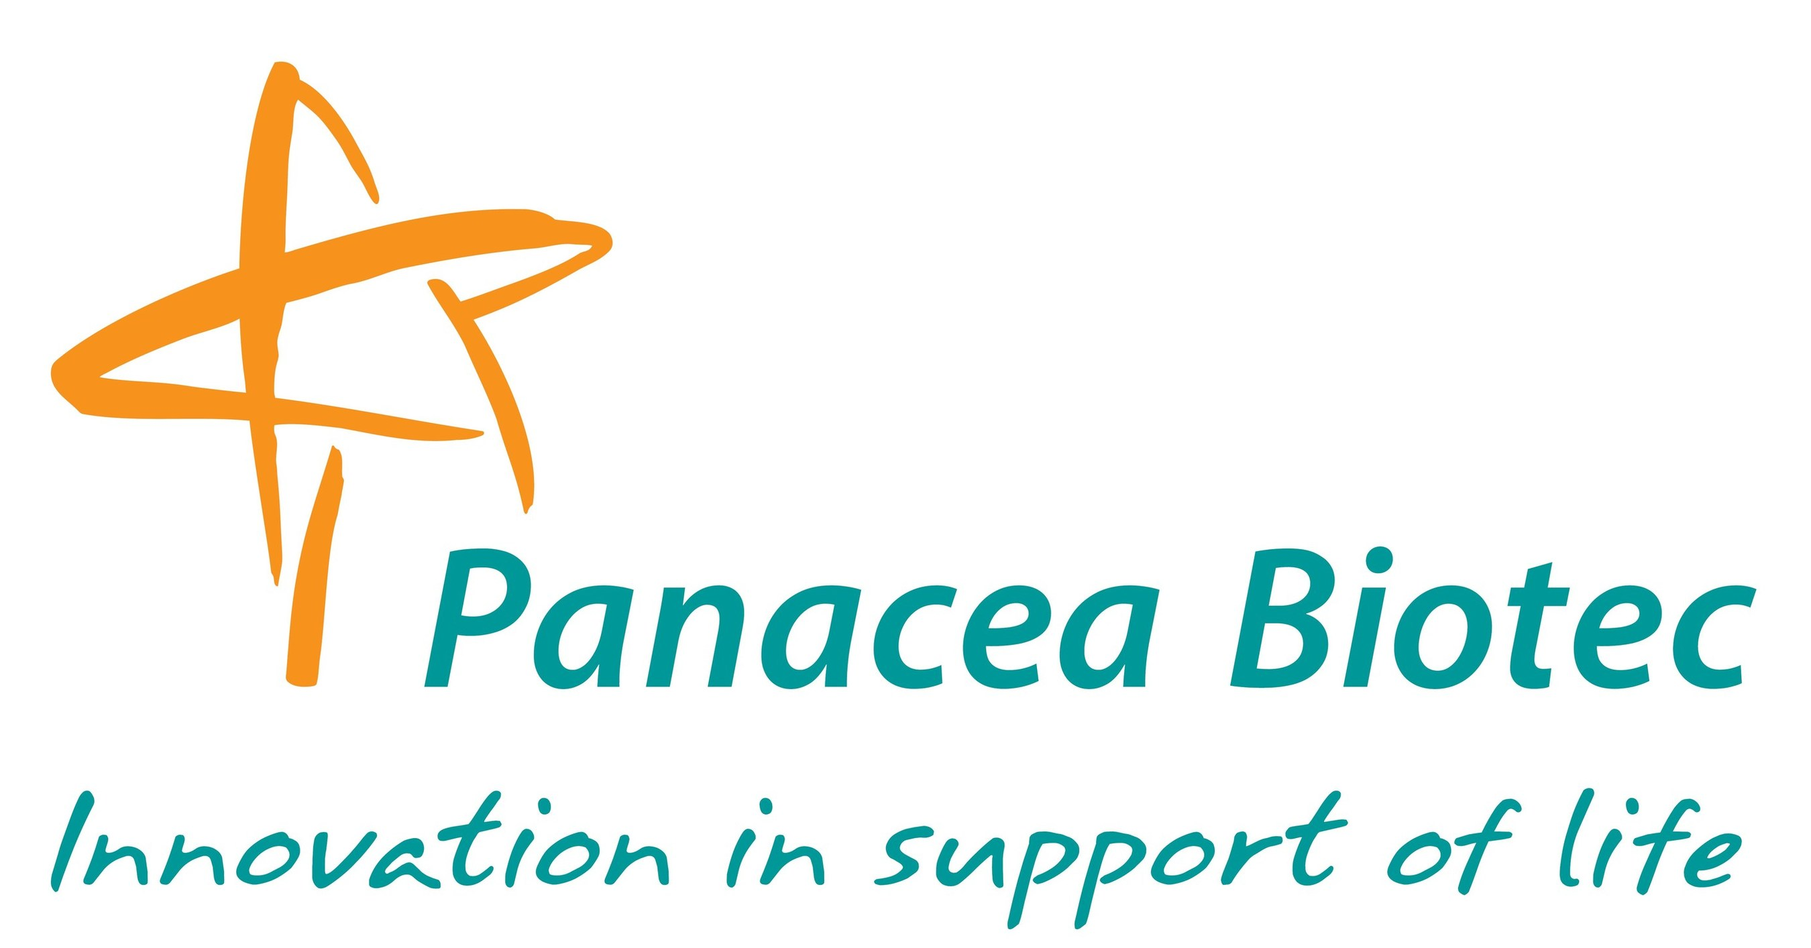
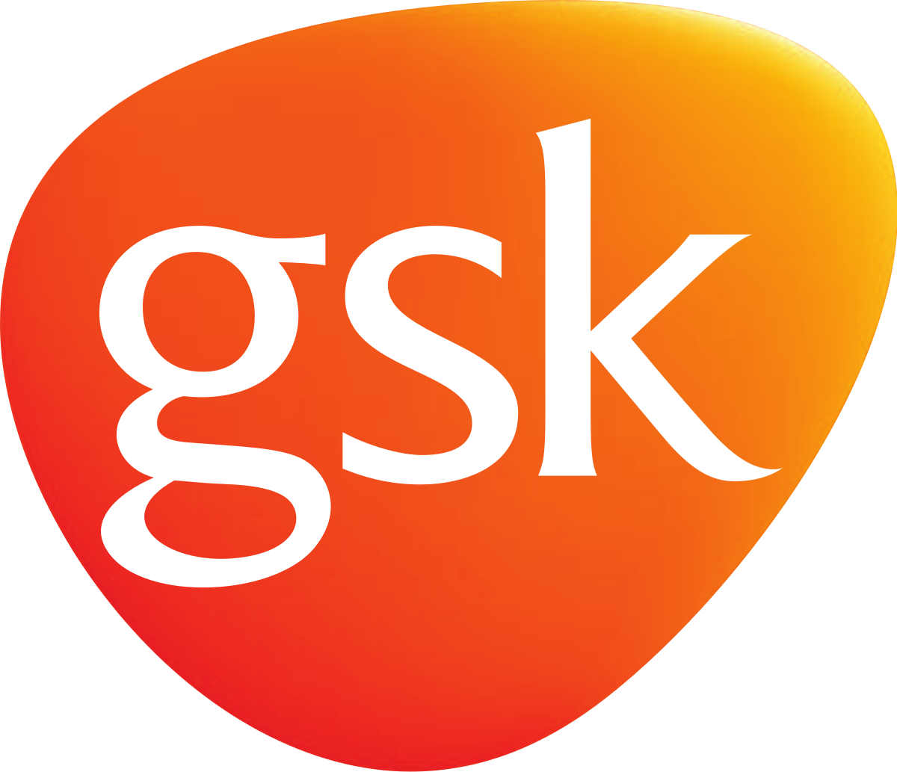

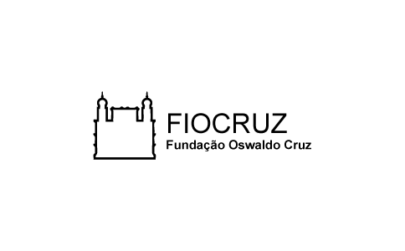
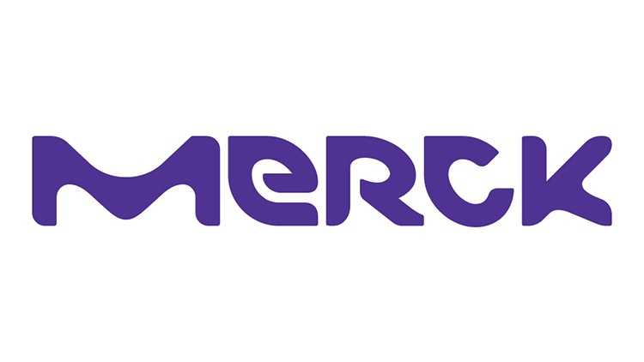



Future Market and Pipeline Products
The overall dengue vaccines market is projected to cross US$ 1.4 Bn by 2031. However, TAK-003 from Takeda is the most advanced vaccine currently in the pipeline.
Sponsor | Product | Development Phase | Vaccine candidate
 | TAK-003 |  | Live-attenuated DENV-2
 | TV003/TV005 |  | Live-attenuated and recombinant vaccine ( TV003 has ten times more of the DENV-2 component than TV005)
 | DengiAll |  | Tetravalent recombinant chimeric
 | TDENV-PIV |  | Dead purified components of the dengue virus with an adjuvant
 | V180 |  | Recombinant subunit dengue vaccine
 | D1ME100 |  | DENV-1 component
 | KD-382 |  | Live attenuated tetravalent dengue vaccine
 | Dengusiil |  | Live attenuated tetravalent vaccine
Phase
3
Phase
3
Phase
2
Phase
1
Phase
1
Naval Medical Research Center (NMRC)
Phase
1
Phase
1
Phase
1
Sun Pharma in collaboration with ICGEB is developing a dengue vaccine which is now proceeding to clinical development Phase II clinical trial on AQCH (a phytopharmaceutical drug, for dengue and COVID-19)
TAK-003 is studied for the prevention of dengue due to any virus serotype in Individuals ages from four to sixty, and aims to file for regulatory in Asia, Latin America, and the European Union
Source: ClinicalTrials.gov; ICHGCP; Anzctr; Takeda; SunPharma; PanaceaBiotech; TransparencyMarketResearch
Notes:
https://clinicaltrials.gov/ct2/show/NCT02747927
https://clinicaltrials.gov/ct2/show/NCT02406729
https://www.panaceabiotec.com/press-release-panacea-biotec-announces-successful-completion-of-phase-i-ii-study-of-its-novel-tetravalent-recombinant-chimeric-dengue-candidate-vaccine-dengiall
https://ichgcp.net/clinical-trials-registry/NCT03110952
https://clinicaltrials.gov/ct2/show/NCT01477580
https://clinicaltrials.gov/ct2/show/NCT00290147
https://www.anzctr.org.au/Trial/Registration/TrialReview.aspx?id=375233
https://ichgcp.net/clinical-trials-registry/NCT04035278
Dengue vaccine pipeline: Are new approvals on the horizon? · Break Dengue
https://www.takeda.com/newsroom/newsreleases/2021/takeda-begins-regulatory-submissions-for-dengue-vaccine-candidate-in-eu--and-dengue-endemic-countries/
https://sunpharma.com/wp-content/uploads/2020/12/Press-Release-Sun-Pharma-ICGEB-announce-collaboration-to-develop-novel-dengue-vaccine.pdf
https://www.icgeb.org/icgeb-with-sun-pharma-for-phase-ii-clinical-trial-on-aqch-for-treatment-of-covid-19-patients/
https://www.transparencymarketresearch.com/dengue-vaccine-market.html

Slide 11
Prateek Kumar Yadav
Associate Project Lead
Prateek.yadav@grailinsights.com
+918401901191

